Slide 1


Slide 2
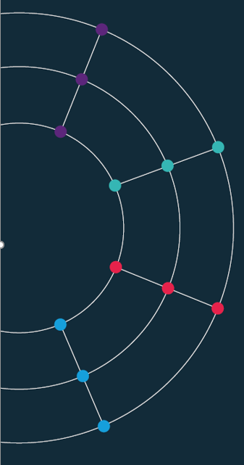
Session 3. Accessing data programmatically

Slide 3
Session 3. Accessing data programmatically
Introduction to control functions

Slide 4
The idea.
Control structures | Flow control | Control statements
We want our programs/analysis to take decisions for us. Not to continue doing the same thing again and again, but to be able to decide what to do next.
Without control structures (AKA ‘flow control’) programs don’t do much.
What might you want a program to do for you?
Stop or start.
Take a decision on what to do next. Do different things in different conditions:
Time of day, or days of the week;
If data has certain properties: (stock market alert).
Do something many times.
Dynamic programming / maximisation;
Batches of analysis: downloading, cleaning, charting.

Slide 5
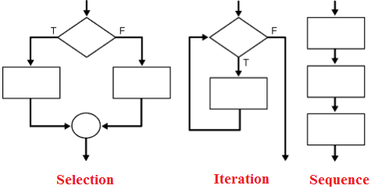
The big three.
Sequence | Iteration | Conditionality/Selection
Programming languages typically feature three types of control:
Sequence. Tells the program the order to do things in.
Selection/conditionality. Makes a decision based on a testable condition.
Iteration. Repeats a command over and over again, until a condition is met. Then stop and continue the code.

Slide 6
Control in data science.
If-else | Loops
In practical terms during a career in data you are going to make daily use two particular examples of these general ideas.
If-else. Test some condition in your data. Based on the results of this test, take a number of different actions.
Loops. Do the same thing to many pieces of data, many variables, many data sets. Or do the same thing on a number of different days.
These can be combined all possible ways.
An if statement inside an if (AKA “nested”)
A loop withing a loop.
If inside a loop
Loop inside an if.

Slide 7





How many languages?
Five?

Slide 8
How many languages?
Three?

Slide 9

Conditionals.

Slide 10

Code as a tree | Conditional statements influence which branch your code goes along.

Slide 11
If-else.
Excel | Python | JavaScript | CSS
Syntax:
IF({CONDITION}, {VALUE IF TRUE}, {VALUE IF FALSE})
Example:
=if(A1=“Richard”, “Yes”, “No”)

Slide 12
If-else.
Excel | Python | JavaScript | CSS
Practical usage:
Data cleaning
You have two data sets on countries that you want to match.
But the names are not consistent.
You want to create a column that provides a 1:1 correspondence between the data sets
=if(A1=“Côte d'Ivoire”, “Ivory Coast”, A1)
Categorisation
You have data on firm size, measured by number of employees…
You want to analyse based on two types, large firms and SMEs..
You define SME as anything with up to 250 employees..
=if(A1>250, “Large”, “SME”)

Slide 13
If-else.
Excel | Python | JavaScript | CSS
# Example: how big are firms in our dataset?
firm1 = 14
firm2 = 250
# Comparing values
if firm1 > firm2:
print("Firm 1 has more employees than Firm 2")
else:
print("Firm 2 has more employees than Firm 1")
# Assessing size
if firm1 > 249:
print("Firm 1 is large")
else:
print("Firm 1 is an SME")

Slide 14
If-else.
Excel | Python | JavaScript | CSS
//Simple if condition
if (condition) {
// Add code here--can be many lines, to run if the condition is TRUE.
// If the condition is FALSE then nothing happens
}
//If else
if (condition) {
// Code to run if condition TRUE.
} else {
// Code to run if condition FALSE.
}
//If-elif-else:
if (conditionA) {
// Code to run if conditionA TRUE.
} else if (conditionB) {
// Code to run if conditionB TRUE.
} else {
// Code to run if BOTH conditionA and conditionB are FALSE.
}

Slide 15
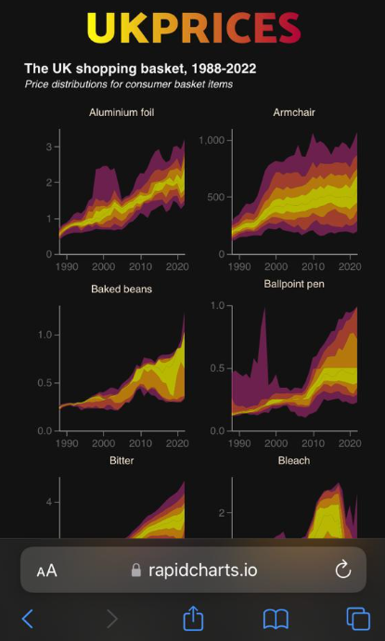
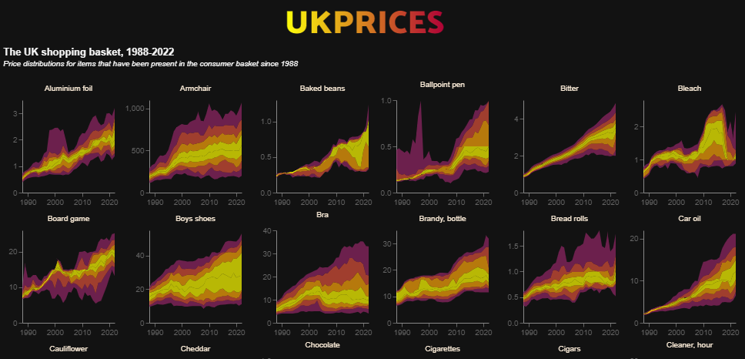
Example: screen sizes
Excel | Python | JavaScript | CSS
Phone
Desktop

Slide 16
Example: screen sizes
Excel | Python | JavaScript | CSS
<!-- CONDITIONAL SCRIPT TO EMBED BASED ON SCREEN WIDTH -->
<script>
// Find the current screen width:
let width = screen.width;
// Use an if function to pick the approprite visualisation:
if (width > 950) {
prices1 = "charts/ONSinflation/distributionsPerrenials_DarkWide.json";
} else if (width > 450) {
prices1 = "charts/ONSinflation/distributionsPerrenials_DarkMedium.json";
} else {
prices1 = "charts/ONSinflation/distributionsPerrenials_DarkNarrow.json";
}
// Now embed the chart, which will vary based on screen width:
vegaEmbed('#chart1', prices1, {"actions": false});
</script>
<!-- END - CONDITIONAL SCRIPT TO EMBED BASED ON SCREEN WIDTH -->

Slide 17
If-else.
Excel | Python | JavaScript | CSS
CSS does not officially support conditionals.
But there is a way we can make CSS react in different ways in different situations?
Media Queries (@media) allow you to change the look based on screen size:
With these you are saying:
If the screen size is {CONDITION} then do this {ACTION}
So CSS does allow conditionals.
Understanding this is the way to make your site have two looks: one for mobile, one for laptop/desktop.

Slide 18
If-else.
Excel | Python | JavaScript | CSS
/* Some CSS to alter the colour of my site */
body{
background-color: white;
}
/* Screen size 1 */
@media screen and (max-width: 450px) {
body {
background-color: lightblue;
}
}
/* Screen size 2 */
@media screen and (max-width: 600px) {
body {
background-color: blue;
}
}
/* Screen size 3 */
@media screen and (max-width: 800px) {
body {
background-color: pink;
}
}
What colour on:
Smartphone?
Laptop?
iPad?

Slide 19
If-else.
Excel | Python | JavaScript | CSS
/* Some CSS to alter the colour of my site */
body{
background-color: white;
}
/* Screen size 1 */
@media screen and (max-width: 450px) {
body {
background-color: lightblue;
}
}
/* Screen size 2 */
@media screen and (max-width: 600px) {
body {
background-color: blue;
}
}
/* Screen size 3 */
@media screen and (max-width: 800px) {
body {
background-color: pink;
}
}
What colour on:
Smartphone? (400px wide)
Laptop? (~1350px)
iPad? (768x1024)

Slide 20
Loops.

Slide 22
Loops.
Excel | Python | JavaScript | CSS
The Excel GUI is not built for iteration.
You can write loops in its background language VBA
This is fiddly

Slide 23
Loops.
Excel | Python | JavaScript | CSS
for i in range (1, 100):
print i
for i in range (1, 10, 100):
print i
for i in range (1, 100, 10):
print i
variables = ["debt", "deficit", "GDP", "inflation"]
for i in variables:
print(i)
An example of subtle differences between languages / functions.

Slide 24
Loops.
Excel | Python | JavaScript | CSS
for (statement_1; statement_2; statement_3) {
// Code block to run
}
What happens here:
Statement_1 runs once, before the code block starts.
Statament_2 defines a condition that must hold for the code block to run.
Statement_3 runs each time the code block has been executed.

Slide 25
Loops.
Excel | Python | JavaScript | CSS
for (let i = 1; i < 101; i++) {
console.log(i);
}
for (let i = 1; i < 101; i+10) {
console.log(i);
}

Slide 26
Loops.
Excel | Python | JavaScript | CSS
// Set a list of variables:
variables = ["debt", "deficit", "GDP", "inflation"]
// We can index these:
console.log(variables)
console.log(variables[0])
console.log(variables[3])
// Work out how long this thing is:
len = variables.length
// Iterate though it, printing out each particular variable
for (let i=0; i<len; i++) {
x = variables[i]
console.log(x)
}

Slide 27
Loops.
Excel | Python | JavaScript | CSS
Again, CSS is not really built for looping
However, it can repeat commands. An example: @keyframes (an At-Rule).
One example is the @keyframes
@keyframes border-pulsate2 {
0% { border-color: #22e68b}
10% { border-color: rgba(230, 34, 75, 0)}
20% { border-color: rgba(230, 34, 75)}
30% { border-color: rgba(230, 34, 75, 0)}
40% { border-color: rgba(0, 47, 167)}
50% { border-color: rgba(230, 34, 75, 0)}
60% { border-color: rgba(250, 250, 0)}
70% { border-color: rgba(230, 34, 75, 0)}
80% { border-color: #22e68b}
}
.readingWeek {
background-color: #122b39;
border-radius: 10px;
border-style: dotted;
border-width: 5px;
height:100%;
animation: border-pulsate2 2s infinite;
}

Slide 28
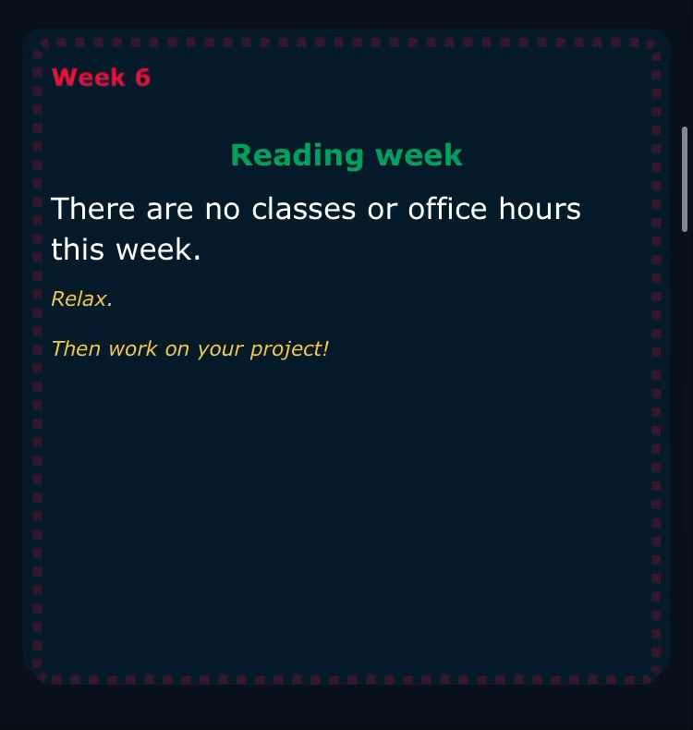
Loops.
Excel | Python | JavaScript | CSS
Again, CSS is not built for looping
However, it can iterate over certain commands for a given time. One example
@keyframes border-pulsate2 {
0% { border-color: #22e68b}
10% { border-color: rgba(230, 34, 75, 0)}
20% { border-color: rgba(230, 34, 75)}
30% { border-color: rgba(230, 34, 75, 0)}
40% { border-color: rgba(0, 47, 167)}
50% { border-color: rgba(230, 34, 75, 0)}
60% { border-color: rgba(250, 250, 0)}
70% { border-color: rgba(230, 34, 75, 0)}
80% { border-color: #22e68b}
}
.readingWeek {
background-color: #122b39;
border-radius: 10px;
border-style: dotted;
border-width: 5px;
height:100%;
animation: border-pulsate2 2s infinite;
}

Slide 29
Using loops
Notes:
RS: insert example of a terrible chart

Slide 30
Using loops.
Batching analysis
Problem: We often have too much data
How can visualising help us understand the data in the early stage of a project?
Code intuition:
Think of a chart that summarises the data in some useful way:
[Useful options: histogram, percentiles as a swathe.]
Code this chart for one part (one firm, one year, one product).
Use a loop: for each product, draw the chart
Example: UK CPI data, which has ~1300 products.
Notes:
RS: insert example of a terrible chart

Slide 31
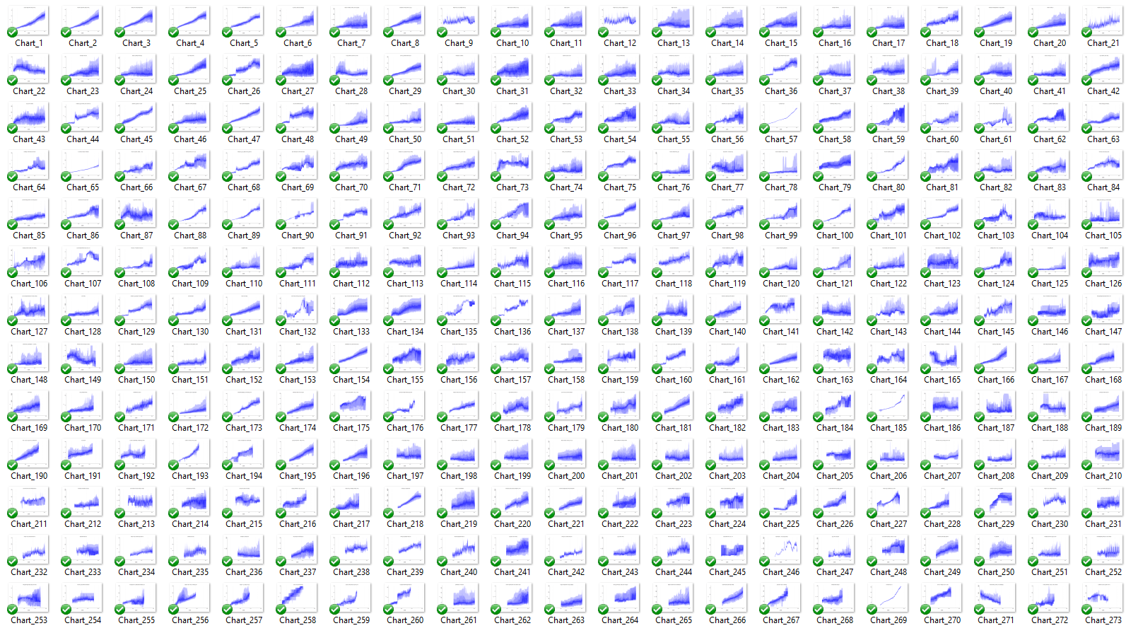
Notes:
RS: insert example of a terrible chart

Slide 32
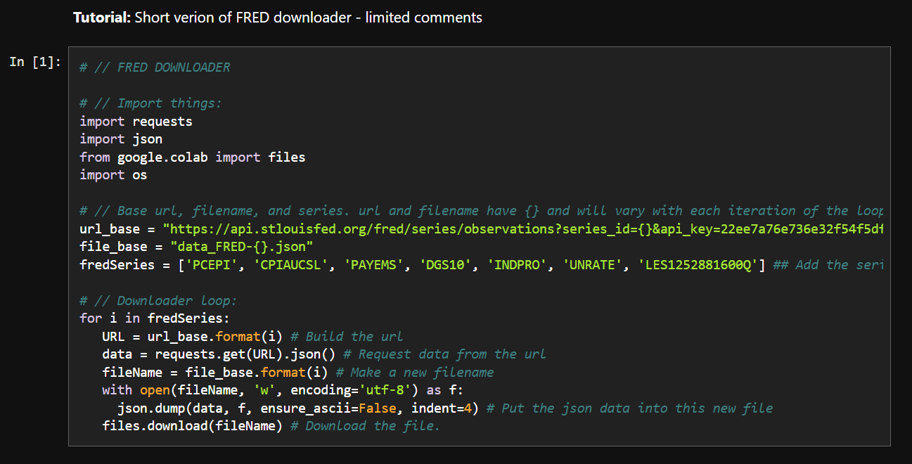
Using loops.
Why are they so helpful?

Slide 33
What is an API?
Application Programming Interface
An API is a software intermediary that allows two applications to talk to each other. They are everywhere: each time you use an app like Facebook or Instagram, send an instant message, or check your weather app on your phone, you are using an API (example: Apple Watch)
APIs are extremely useful to developers and data scientists because they provide a way to share/access abstracted data and display/use it in a chosen setting

Slide 34
APIs and data science.
APIs are useful for data scientists because they allow us to automate data collection. Rather than manually downloading new data and re-uploading it to a server (like GitHub), we can ask our computer to ‘talk’ to another computer
Some examples:
Covid-19 UK official data
Office for National Statistics
Nomics (cryptocurrencies)
Emissions

Slide 35
API guidance.
They all look different but have a similar set up.
A base url: e.g. https://api.stlouisfed.org/fred/series/observations?
A series of options you can choose: series_id= file_type= time_start=
Often a request for your API key: api_key=
Often, when the API requires more information/choices from you, a series of & symbols. An example:
https://api.stlouisfed.org/fred/series/observations?series_id=UNRATE&api_key=22ee7a76e736e32f54f5df0a7171538d&file_type=json

Slide 36
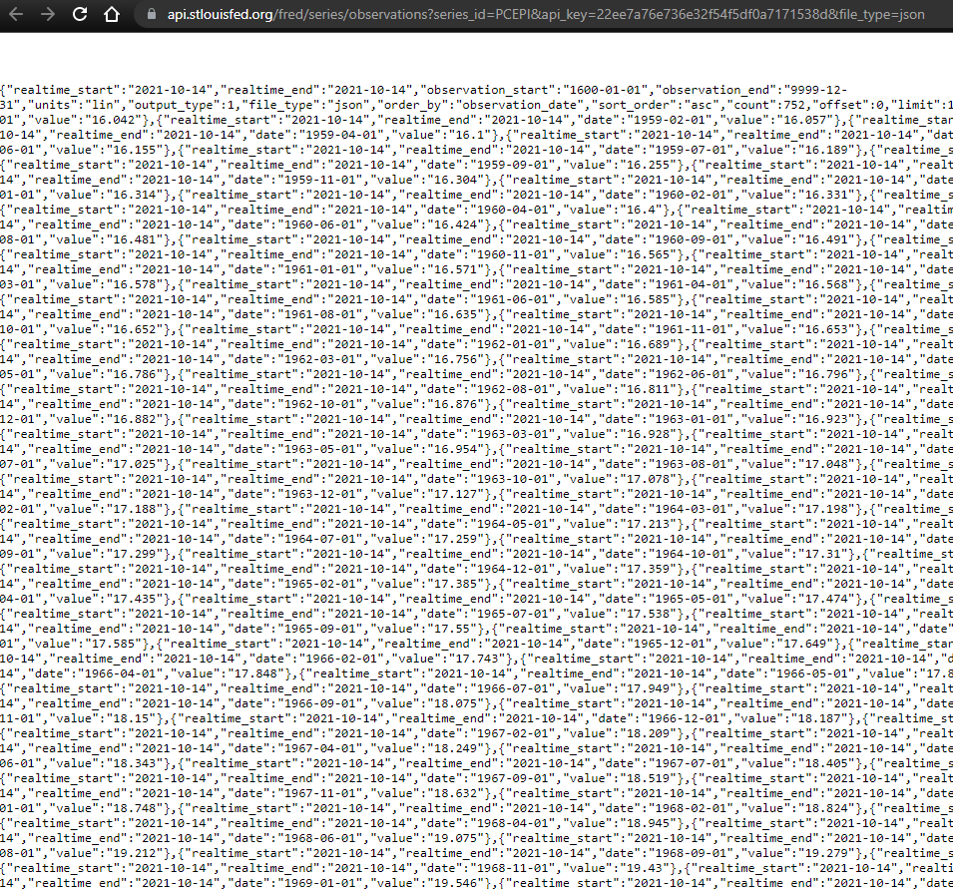

Raw JSON.
Download a JSON formatter plug in for your browser

Slide 37
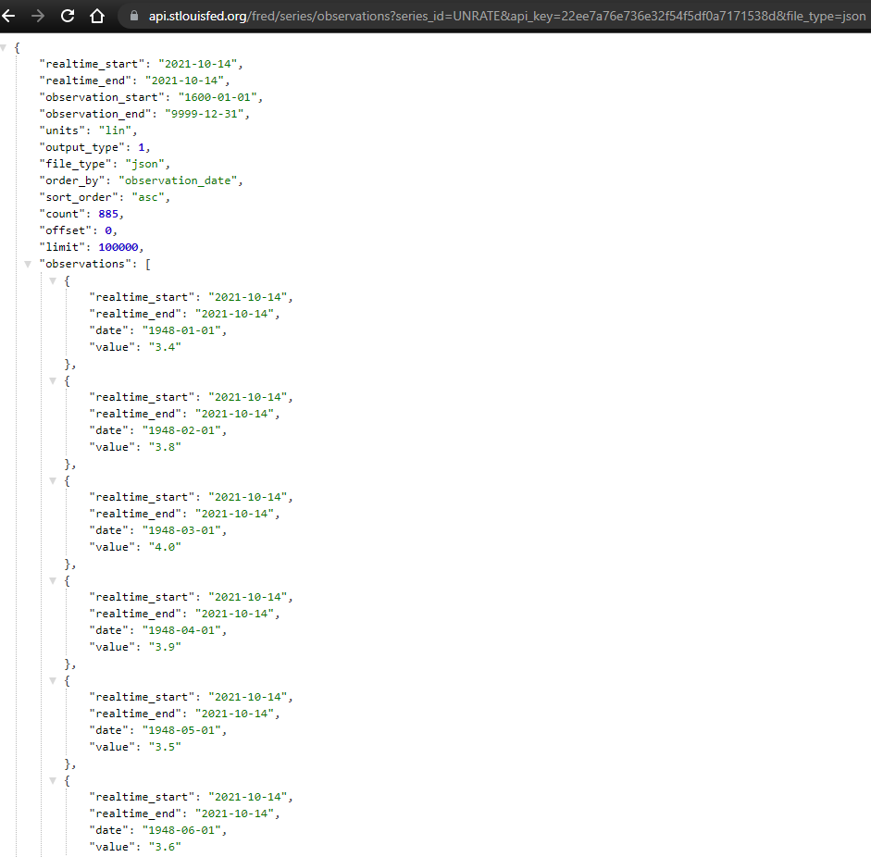

Slide 38
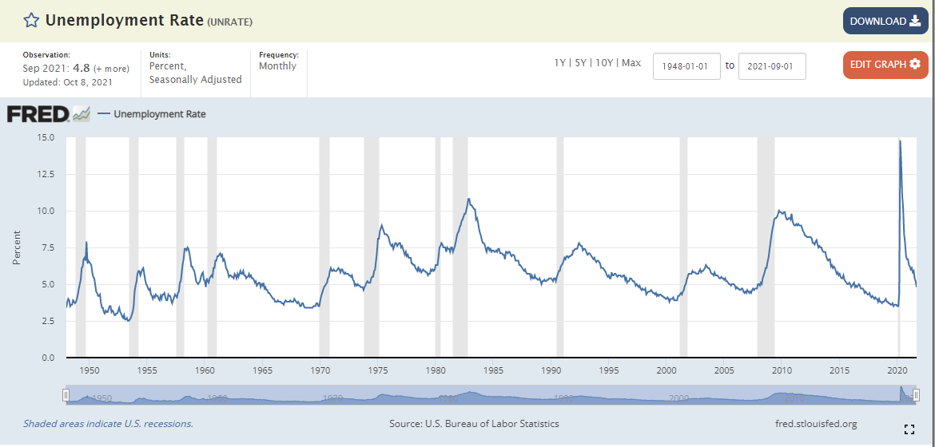

Slide 39
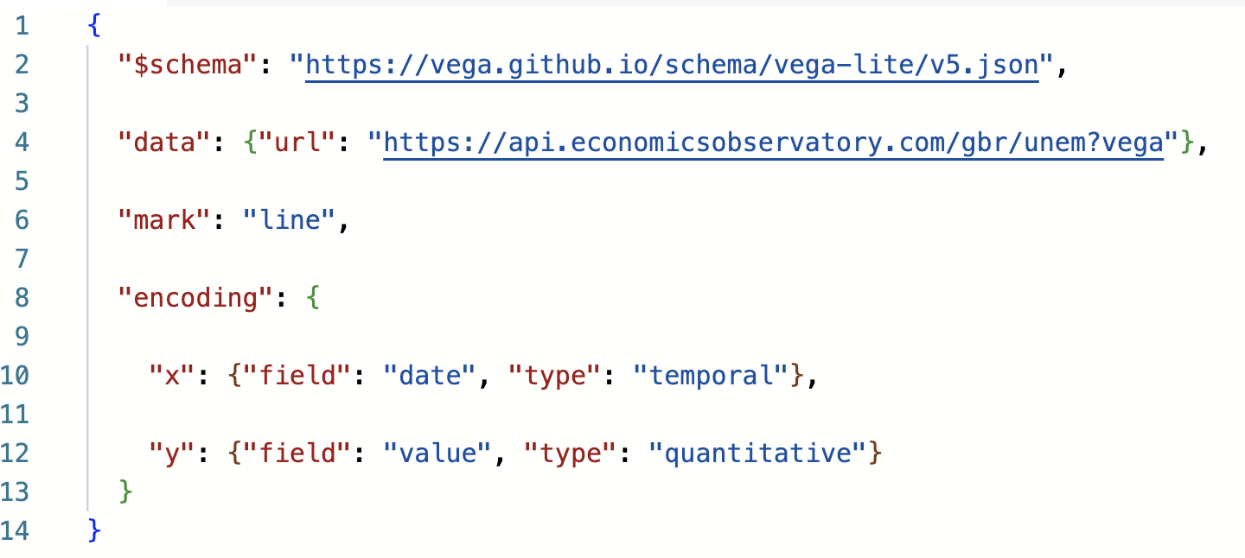
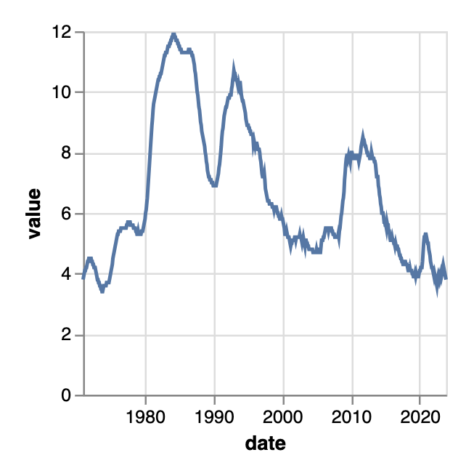
Worked example.
This chart pulls data from the Economics Observatory API:

Slide 40
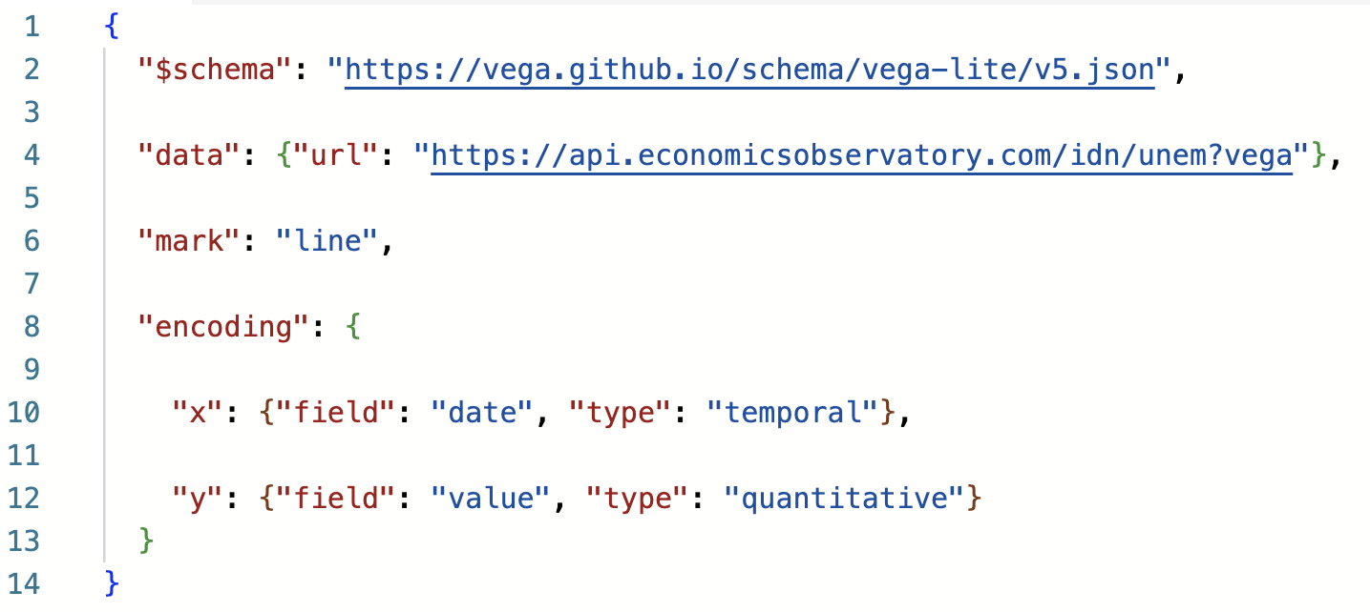
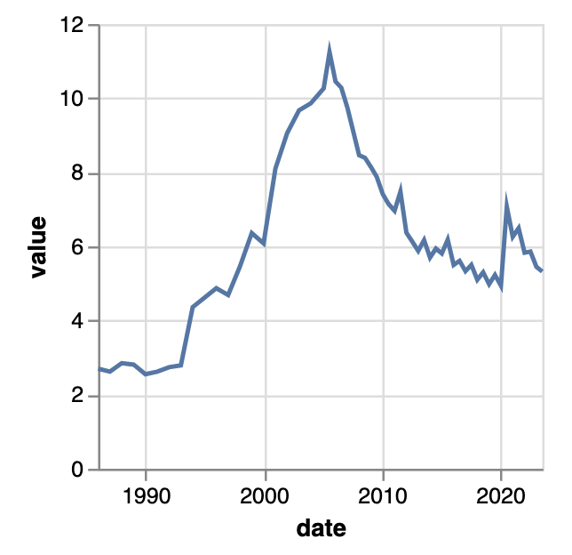
Worked example.
Chart now shows Indonesian data
API URL tweaked
Edit the URL to draw data from a different country:
Notes:
Indonesia

Slide 41
Session 3. Accessing data programmatically
Code-along and automated data access

Slide 42
Session 3. Accessing data programmatically
https://github.com/EconomicsObservatory/courses/blob/main/README.md

Slide 43
Code-along.
In this third practical session, we will be using Google Colab to explore Python, and then edit your website using VS Code and GitHub.
Quick introduction to APIs
Use Python to batch download data
Embed a chart using data accessed via batch download

